Slide 1


Tech Instagram Influencer Analysis
SQL-Based Performance & Engagement Insights
Presented by: Savitha M
Date: 01-05-2026

Slide 2
OBJECTIVE
Analyze Instagram account performance
Identify high-performing content types
Understand engagement trends
Provide data-driven recommendations

Slide 3
DATASET OVERVIEW
Dataset consists of 3 tables:
dim_dates → Date-level information
fact_account → Profile visits & followers
fact_content → Post-level engagement
Metrics Analyzed:
Reach
Impressions
Likes, Comments, Saves
Shares & Followers

Slide 4
DATA PREPARATION
Standardized column names (snake_case)
Converted data types (VARCHAR → INT)
Added column metadata for clarity
Validated joins between tables

Slide 5
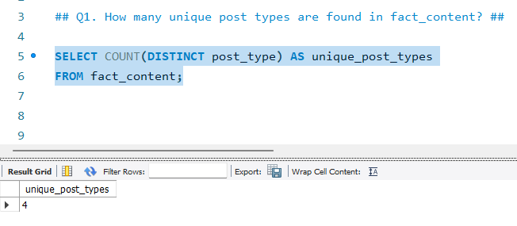
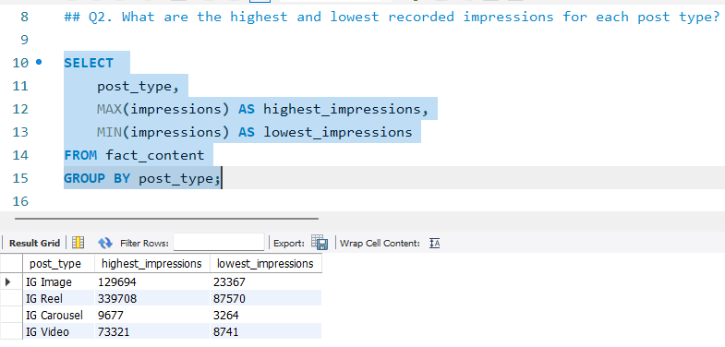
CONTENT TYPE ANALYSIS (Q1 & Q2)
Identified unique post types
Compared highest & lowest impressions
Evaluated performance variation

Slide 6
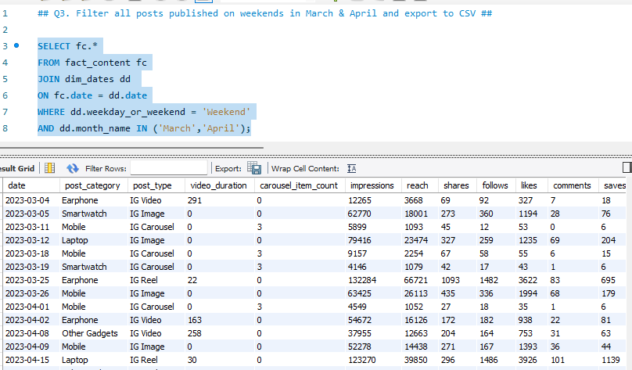
WEEKEND ANALYSIS (Q3)
Filtered posts from March & April
Selected only weekend content
Exported data for further analysis

Slide 7
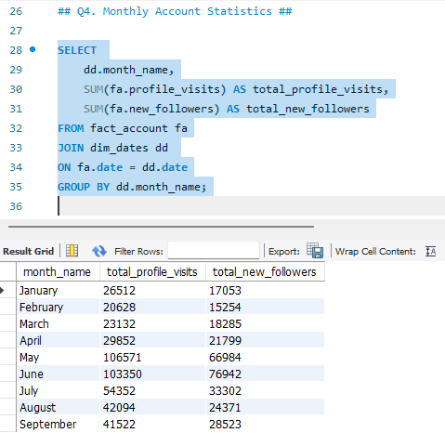
MONTHLY GROWTH (Q4)
Aggregated profile visits by month
Calculated new followers per month
Identified growth trends

Slide 8
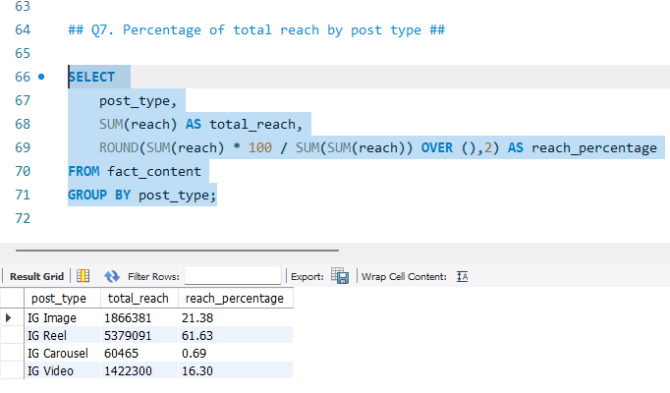
ENGAGEMENT INSIGHTS (Q5, Q6, Q7)
Identified top-performing content categories using likes
Analyzed content diversity across months
Calculated reach contribution by post type

Slide 9
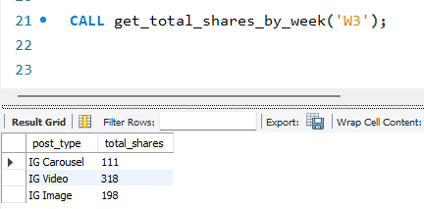
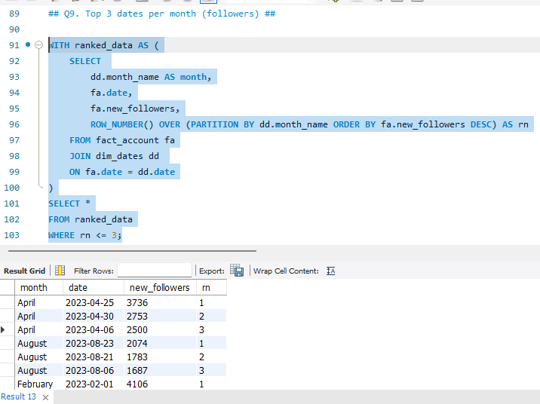
ADVANCED ANALYSIS (Q8, Q9, Q10)
Performed quarter-wise engagement analysis
Identified top-performing dates using ranking
Built reusable stored procedure for dynamic reporting

Slide 10
KEY INSIGHTS
Reels and video content drive higher reach
Certain categories (like Mobile/Gadgets) perform better
Engagement varies across months and weeks
Posting timing impacts follower growth

Slide 11
RECOMMENDATIONS
Focus on high-performing content formats
Optimize posts for top-performing categories
Maintain consistent posting schedule
Leverage high-engagement periods

Slide 12
CONCLUSION
Data-driven decisions improve content strategy
SQL enables deep analytical insights
Helps maximize reach and engagement

Slide 13
THANK YOU

